Slide 1
本质图像论文汇报（三）
汇报人：方阳

Slide 2
Content
1. Deep Specialized Network for Illuminant Estimation（ECCV2016）

Slide 3
Deep Specialized Network for Illuminant Estimation
Wu Shi¹, Chen Change Loy^{1,2}, and Xiaoou Tang^{1,2}
¹Department of Informaiton Engineering, The Chinese University of Hong Kong,
²Shenzhen Institutes of Advanced Technology, Chinese Academy of Sciences.

Slide 4
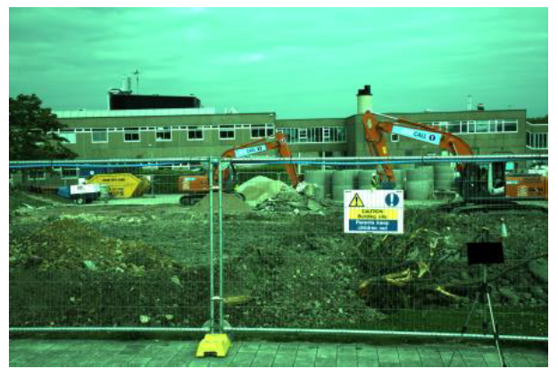
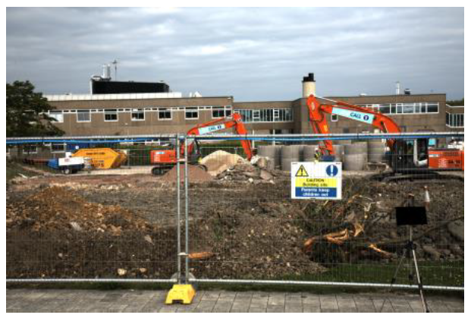

Background
E is the RGB illumination, R is the RGB value of reflectance under canonical (often white) illumination

Slide 5
Contributions
Design a single network (i.e. a HypNet) to output multiple hypotheses, which resembles multiple expert networks in an ensemble.
A diversity-encouraging `winner-take-all' learning scheme is proposed to train the specialized network
Design a separate network (i.e. a SelNet) for hypothesis selection.
HypNet + winner-take-all learning scheme + SelNet !

Slide 6

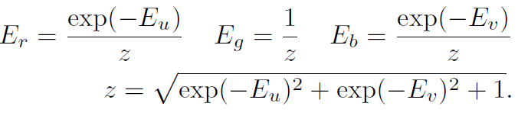
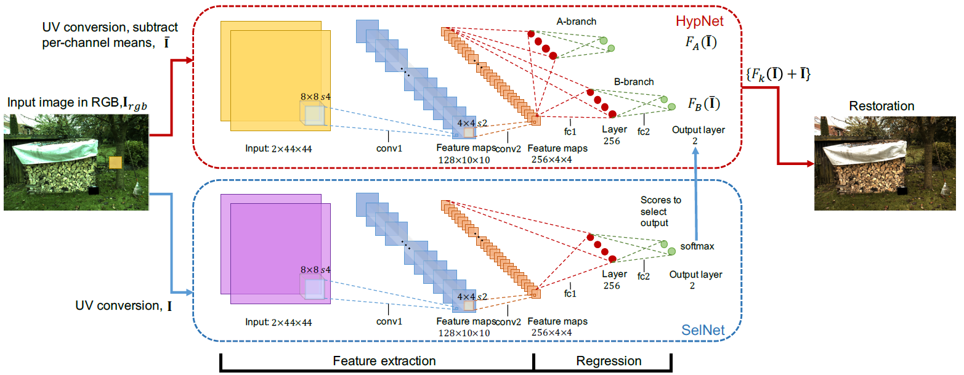
Model
Notes:
we have 2 unknown instead of 3, and R and I are related by simple linear constraint instead of a multiplicative constraint.

Slide 7
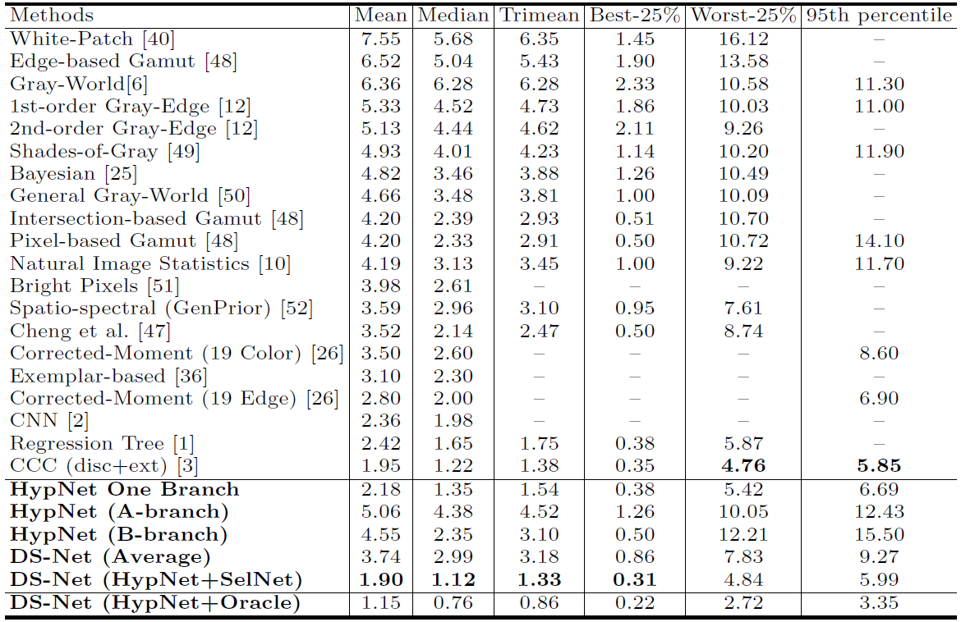
Experiments——Color Checker dataset

Slide 8
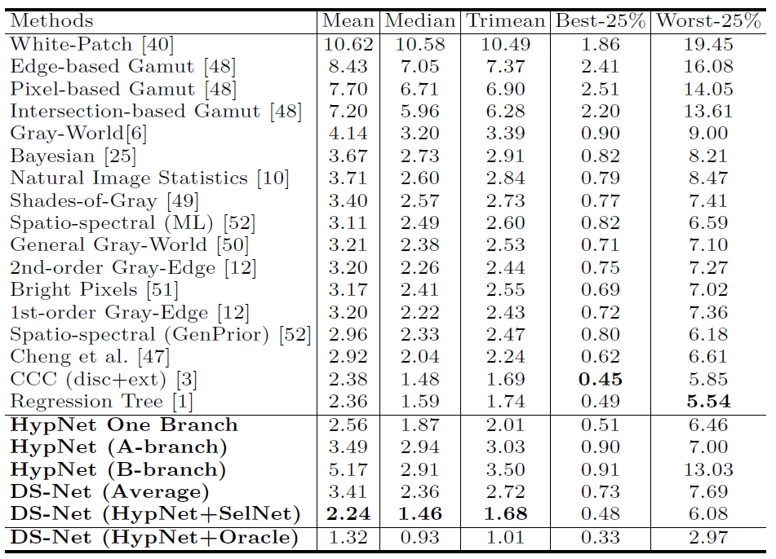
Experiments——NUS 8-camera datasets

Slide 9
